Slide 1
CHRODIS PLUS Joint Action
General presentation – Spring 2018
Matilde Leonardi
Leader WP8 Employment and Chronic Conditions

Slide 2
Co-funded
by the Third Health Programme
of the European Union
MEMBER STATES
STEP UP TOGETHER
TO SHARe
INNOVATIVE
PRACTICES
AND POLICIES
TO ALLEVIATE
THE BURDEN OF
CHRONIC DISEASES
CHRODIS PLUS
Joint Action
2017-2020
42 partners representing
21 European countries
chrodis.eu

Slide 3
Facing the impact of chronic diseases together
The EU and chronic diseases
Reducing the burden of chronic diseases such as diabetes, cardiovascular disease, cancer and mental disorders is a priority for EU Member States and at the EU Policy level, since they affect 8 out of 10 people over the age of 65 in Europe.
A heavy price for chronic diseases
It has been estimated that chronic diseases cost EU economies €115 billion or 0.8% of GDP annually. Approximately 70% to 80% of healthcare budgets across the EU are spent on treating chronic diseases.
Source: OECD publication Health at a Glance: Europe 2016
Source: European Journal of Public Health, Vol. 26, Supplement 1, 2016

Slide 4
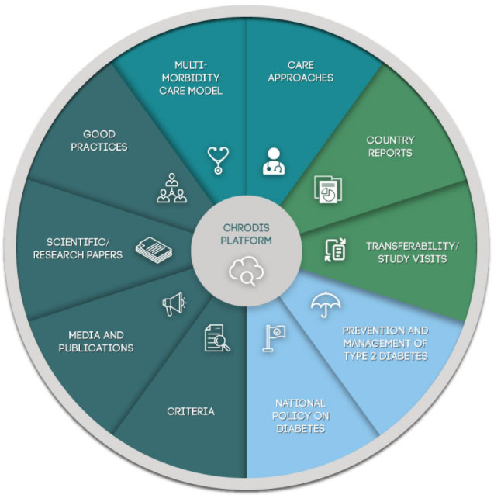
Background Joint Action CHRODIS (2014-2017)
The CHRODIS PLUS Joint Action builds upon the results of JA CHRODIS
Key facts about Joint Action CHRODIS
operated under the EU Health Programme
39 associated partners + 32 collaborating partners from 25 countries
3-year duration (January 2014 – March 2017)
To identify, exchange, scale-up and transfer good practices and effective interventions for
JA CHRODIS OBJECTIVES
multimorbidity & diabetes
health promotion and chronic disease prevention
The JA CHRODIS results are available on the CHRODIS PLUS website: http://chrodis.eu/outcomes-results/

Slide 5
The mission of the CHRODIS PLUS Joint Action
In a health-promoting Europe, initiatives on chronic diseases should build on
four PILLARS
1
2
3
4
health promotion and primary prevention as a way to reduce the burden of chronic diseases
patient empowerment
Considering functional decline of the body and A low quality of life as the main consequences of chronic diseases
making health systems sustainable and responsive to the ageing of our populations

Slide 6
Reaching CHRODIS PLUS objectives
CHRODIS PLUS contributes to reducing the burden of chronic diseases in Europe by
imPLementing and testing best practices, tools and policies in implementation projects
sharing the experiences gained during these implementation projects across tHE EU
supporting integration inTO national policies and sustainability
1
2
3

Slide 7
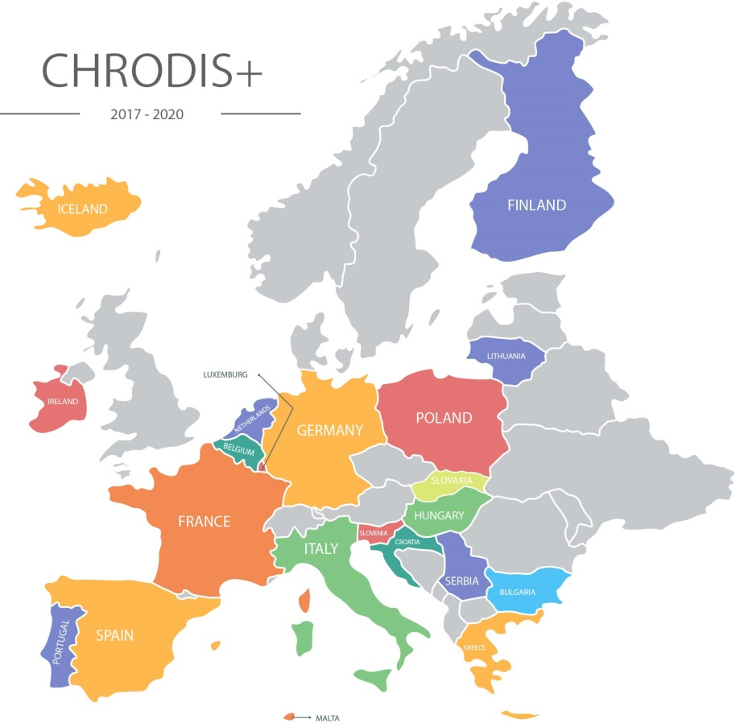
Countries contributing to CHRODIS PLUS
Belgium
Hungary
Netherlands
Bulgaria
Iceland
Poland
Croatia
Ireland
Portugal
Finland
Italy
Serbia
France
Lithuania
Slovakia
Germany
Luxembourg
Slovenia
Greece
Malta
Spain

Slide 8
CHRODIS PLUS beneficiaries
List does not include collaborating partners and pilot project implementers
Belgium
Greece
Lithuania
Serbia
Federal Public Service Health, Food Chain Safety and Environment
Flemish Region
Aristotle University of Thessaloniki
Centre for Research and Technology Hellas
Institute of Hygiene
The Hospital of Lithuanian University of Health Sciences Kauno Klinikos
Vilnius University
Vilnius University Hospital Santaros Klinikos
Institute of Public Health of Serbia
Faculty of Medicine, University of Belgrade
Bulgaria
Hungary
Slovakia
National Center of Public Health and Analyses, Sophia
Semmelweis University
National Institute of Oncology
The Ministry of Health of the Slovak Republic
Croatia
Malta
Slovenia
Croatian Institute of Public Health
Iceland
Ministry for Health, Government of Malta
National Institute of Public Health
Finland
The Directorate of Health
Netherlands
Spain
Finnish Institute of Occupational Health
Technical Research Institute Finland
National Institute for Health and Welfare
Ireland
The Dutch National Institute for Public Health and the Environment
Agency for Health Quality and Assessment of Catalonia
Regional Ministry of Health of Andalusia
Cantabria Council of Health
Institute of Health Sciences of Aragon
International Centre of Excellence in Chronicity Research
Institute of Health Carlos III
Health Service Executive
Institute of Public Health
Poland
France
National Institute of Geriatrics, Rheumatology and Rehabilitation
The French National Cancer Institute
Italy
Germany
Local Health Services of Turin
The Foundation of the Carlo Besta Neurological Institute, IRCCS
Superior Health Institute
Catholic University of the Sacred Heart
Portugal
Otto von Guericke University Magdeburg
Technical University of Dresden
University Hospital Regensburg
University of Ulm
Ministry of Health
Europe
EuroHealthNet
European Patients’ Forum

Slide 9
Key CHRODIS PLUS Actors and Stakeholders
STAKEHOLDERS
STAKEHOLDERS
TAKEHOLDER
Implementers
Executive Board
Governing Board
Beneficiaries
Collaborating partners
TAKEHOLDER

Slide 10
The Joint Action’s core Implementation Projects & Policy Dialogues
17 policy dialogues
15 at the national level, and 2 at the EU level
policy dialogues contribute to informing, developing or implementing a policy change following a round of evidence-based discussions, workshops, and consultations on a particular subject
25 implementation projects in four major areas
Health promotion and disease prevention: 5 practices implemented by 8 organisations
Multimorbidity Care Model: 1 model implemented by 5 organisations
Quality Criteria Recommendations: 1 tool implemented by 8 organisations
Employment and Chronic Diseases: 1 tool implemented by 4 organisations

Slide 11
Policy dialogues
Employment and chronic diseases
Policy dialogues at the EU level
Innovative financing of health promotion
Policy dialogues at the national level
Alcohol regulation
People in vulnerable situations
Childhood obesity
Cancer screening
Integrated
care
Nutrition and physical activity
Tobacco control
Inter-sectoral collaboration
Innovative funding for health promotion
Employment of people with chronic diseases
National health promotion and prevention planning
Monitoring of chronic diseases and data collection

Slide 12
Implementation Projects 1. Health Promotion and Disease Prevention
“Active School Flag”
Good practice from Ireland
increase the physical activity of schoolchildren by developing a physically active and educated school community
5 projects implemented by 8 organisations in Europe
to improve national approaches For
promoting health and preventing diseases
“JOGG”
Good practice from the Netherlands
encourage people in a town or neighbourhood to make healthy food and exercise an easy and attractive lifestyle option for young people in order to address obesity
AIM
“Toy Box”
Good practice from Greece
promote water consumption, healthy snacking, physical activity and the reduction of sedentary time in preschool children and their families
“Lombardy Workplace Health Promotion Network”
Good practice from Italy
promote a healthy lifestyle through different actions and information that targets healthy eating, smoking cessation, increased physical activity, alcohol reduction and safe walking/biking to work
“Successful Ageing”
Good practice from Iceland
multicomponent training, which includes physical activity and nutrition and health guiding to prevent health risks among older people (71-90)

Slide 13
Implementation Projects 2. Integrated Care Model for Multimorbidity
Projects implemented by 5 organisations test the Multimorbidity Care Model
Model developed by JA-CHRODIS
Sixteen components of the model are classified under five domains:
The implementation projects aim to prove the applicability of the model across different European healthcare settings.
Delivery of Care
Decision Support
Self Management Support
Information Systems and Technology
Social and Community Resources

Slide 14
Implementation Projects 3. Fostering the Quality of Care
Quality Criteria and Recommendations Tool
A tool developed by Joint Action CHRODIS (2014-2018) to improve the quality of care for people with chronic diseases
The tool will be tested by 5 institutions as a part of CHRODIS PLUS (2017-2020)
mHealth applications
The tool will be tested by 3 institutions as a part of CHRODIS PLUS (2017-2020)
tool for decision-makers, healthcare providers, patients and healthcare personnel
to evaluate and support the implementation of good practices
to improve the quality of care for people with chronic diseases

Slide 15
Implementation Projects 4. Employment and Chronic Diseases
The CHRODIS PLUS Training Tool for employers & the employment sector
To help employers understand the operational benefits of
The CHRODIS PLUS Toolkit for the Adaptation of the Workplace
An evidence-based, practice-oriented guide for employers to adapt their work environments to support healthy lifestyles and prevent and manage chronic diseases in work settings
The Toolkit provides employers with support for understanding the importance of work environments + the benefits of health promotion and chronic disease prevention, in order to promote the implementation of prevention activities for all workers and identified high-risk groups
- inclusion AND
- re-integration into the workplace
of people suffering from chronic diseases

Slide 16
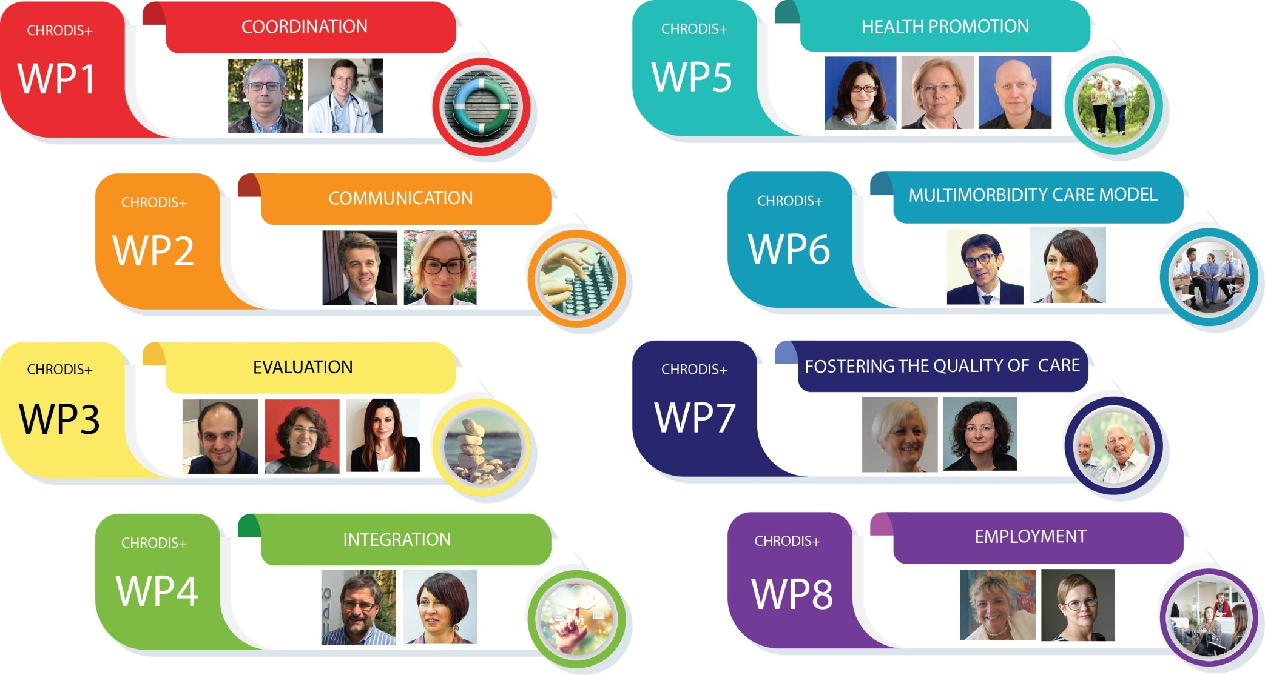
Work Package Leaders

Slide 17
Contact and follow us
chrodis.eu
info@chrodis.eu
Please follow us on social media to stay up to date with the latest news on CHRODIS PLUS
Twitter: @EU_CHRODISplus
Facebook: EU_CHRODIS
YouTube: EU_CHRODISplus

Slide 18
CHRODIS PLUS The Joint Action implementing good practices for chronic diseases
Thank you for your attention
This presentation is part of the CHRODIS PLUS Joint Action. This Joint Action addresses chronic diseases through cross-national initiatives identified in JA-CHRODIS, in order to reduce the burden of chronic diseases while assuring health system sustainability and responsiveness, under the framework of the Third Health Programme (2014-2020). The content of this presentation is the sole responsibility of the author. Consumers, Health, Agriculture and Food Executive Agencies cannot be held liable for any use of the information contained within this document.

Slide 19
Extra Blank Slides
for any additional information
19

Slide 20
Title
Text

Slide 21
Title
Text

